Slide 1
Predicting Tech Salaries: A Data-Driven Analysis of U.S. Labor Statistics
DATA 606: Capstone Project
Summer 2025- Dr. Unal Sakoglu
Team A
Dereck Román Rosario
Simran Shah
Gelareh Vakili
Notes:
“Hello everyone. We’re Team A—Simran Shah, Gelareh Vakili, and Dereck Román Rosario—and our project is titled Predicting Tech Salaries: A Data-Driven Analysis of U.S. Labor Statistics.
This project focuses on building machine learning models to predict developer and tech-sector salaries in the United States using government-sourced labor statistics. We chose this topic because salary transparency and regional equity in the tech industry are increasingly important in workforce development and public policy.”

Slide 2
Project Repository – DevPay Insights
Project Repository:
https://github.com/DATA606-Capstone-Project/devpay-insights
Repository Highlights:
Current Status:
Organized into subfolders: data/, notebooks/, docs/, results/, and src/
Contains full EDA and modeling notebooks for both BLS and Stack Overflow datasets
Environment setup via requirements.txt; repository is MIT licensed
README outlines the project objective, methodology, and dataset usage
Actively maintained by team members: Dereck Román Rosario, Simran Shah, and Gelareh Vakili
Latest modeling and data cleansing updates pushed
Phase 2 slides will be uploaded for full documentation
Visualization outputs and code walkthroughs are accessible in notebooks
Notes:
“We’re managing our project on GitHub, where you’ll find our datasets, notebooks, EDA visualizations, and source code.
The repo is organized into data, docs, notebooks, and results folders. We also included a detailed README with our project objectives and setup instructions.
We’re maintaining it collaboratively, and updates are synced weekly as we progress through phases.”

Slide 3
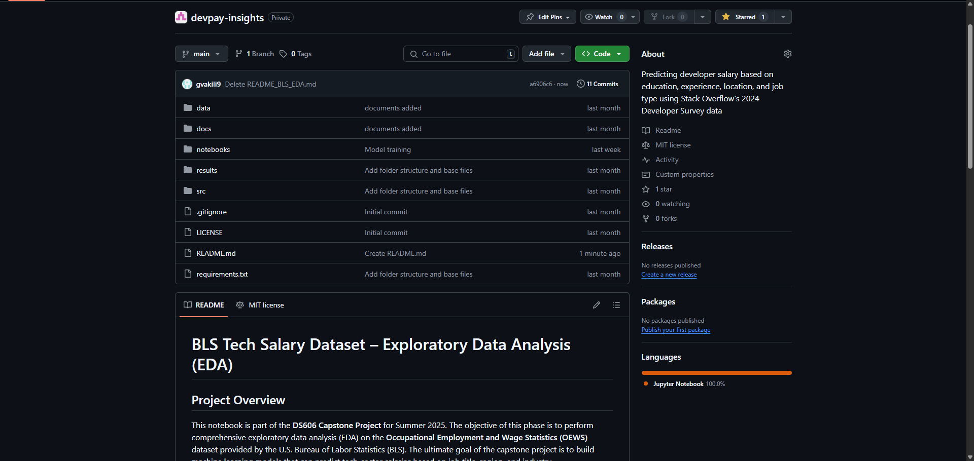
screenshot of the GitHub repo homepage

Slide 4
Project Summary and Objective
Project Title:
Predicting Tech Salaries: A Data-Driven Analysis of U.S. Labor Statistics
Objective:
Develop a supervised machine learning model to predict salaries in the U.S. tech sector. The project uses government labor statistics to identify how factors like occupation, industry, and geography influence compensation.
Why This Matters:
Enhances transparency in tech compensation
Informs policy, workforce planning, and career decision-making
Uses standardized, non-self-reported data for model reliability
ML Task:
Type: Regression
Target Variable: Annual median wage (A_MEDIAN)
Outcome: Predict salary across occupations and regions

Slide 5
Primary Dataset: U.S. Bureau of Labor Statistics (OEWS)
Source:
U.S. Bureau of Labor Statistics (BLS)
Download Link
Dataset Properties:
~400,000 records 32 columns
Covers all U.S. states and metro regions
Includes wage, employment, occupation, and industry data
Format: Excel (XLSX), government-verified, public domain
Key Variables:
OCC_TITLE: Occupation title
AREA_TITLE: Region
NAICS_TITLE: Industry sector
TOT_EMP: Total estimated employment
A_MEDIAN, A_MEAN: Median and mean annual wage
Notes:
“Our primary dataset is the Occupational Employment and Wage Statistics, or OEWS, from the Bureau of Labor Statistics.
It’s publicly available, regularly updated, and used in official government and economic research.
We’re working with the 2024 release, which provides detailed employment and wage information across the U.S. by occupation and location.”

Slide 6
What Has Been Done Before?
Existing Approaches:
Stack Overflow Developer Survey: Used in many community dashboards and salary comparison tools; primarily descriptive.
Glassdoor & Levels.fyi Studies: Self-reported data analyzed using simple regression or filtering by job title and location.
BLS Reports: Government publications often visualize wage distributions but lack predictive modeling.
Common Limitations:
Heavy reliance on self-reported data, often international and inconsistent.
Most work is descriptive, lacking predictive or inferential modeling.
Limited integration of structured public datasets like BLS OEWS.

Slide 7
Filling the Gaps: Our Distinctive Approach
Gaps in Prior Work:
Our Contribution:
Optional Extensions:
Minimal use of structured, U.S. government labor datasets in machine learning
Few predictive models using regional and occupational features
Lack of reproducibility in dashboards and survey-based tools
Public, reproducible data: Using the BLS OEWS dataset, which is standardized and verifiable
Predictive Modeling: Implementing regression to forecast salaries across occupations and regions
Feature Engineering: Incorporating geographic, occupational, and industry-level variables Transparent Workflow: Full pipeline documented and version-controlled on GitHub
Clustering occupations and regions
Cross-validating insights with the Stack Overflow Developer Survey (2024)

Slide 8
Preparing the BLS OEWS Dataset for Modeling
Cleaning & Filtering Steps
Loaded raw Excel file into a DataFrame using pandas
Dropped rows with suppressed or missing wage and employment data
Filtered out:
Summary/aggregate rows (e.g., “All Occupations”)
Invalid or unknown area codes
Records with placeholder or zero salary values
Standard Occupational Classification (SOC) codes Group Filtering: We filtered only major occupation groups relevant to tech → Example: 15-xxxx = Computer and Mathematical Occupations
Keyword Filtering: We further filtered job titles using tech-related keywords such as “developer,” “engineer,” “data,” “IT,” and “cyber.”
Notes:
“Here’s our planned pipeline. We started by cleaning the BLS dataset—removing suppressed rows and filtering for valid occupations and states. We’ll encode categorical variables like region and job title, normalize wages if needed, and test multiple regression models, including Linear Regression, Random Forest, and XGBoost. If time permits, we’ll also explore clustering and compare results with the SO dataset.”

Slide 9
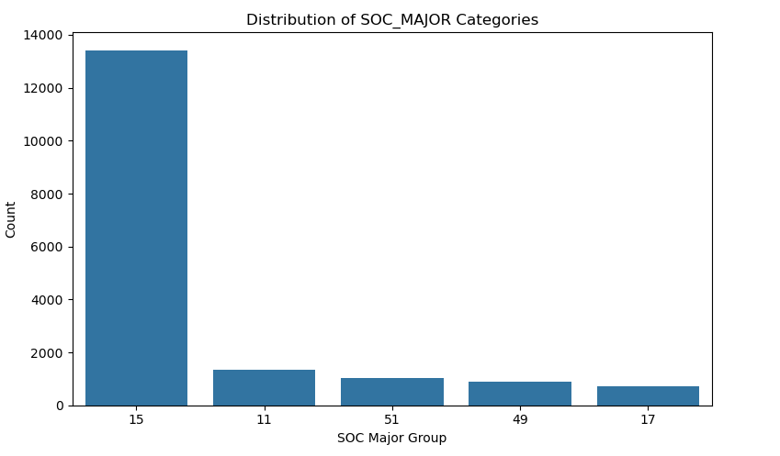

Slide 10
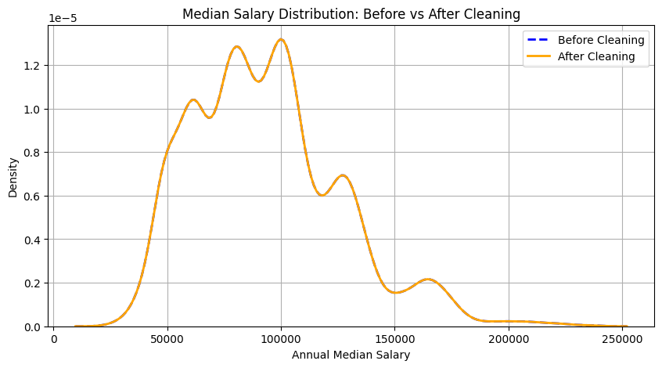
Preparing the BLS OEWS Dataset for Modeling
After Cleaning:
Unique job titles before cleaning: 29
Unique job titles after cleaning: 29
KDE plot, before and after cleaning was plotted, the shape and range of the distribution remain consistent, confirming that we did not lose valuable salary insights during the cleaning process.
Notes:
“Here’s our planned pipeline. We started by cleaning the BLS dataset—removing suppressed rows and filtering for valid occupations and states. We’ll encode categorical variables like region and job title, normalize wages if needed, and test multiple regression models, including Linear Regression, Random Forest, and XGBoost. If time permits, we’ll also explore clustering and compare results with the SO dataset.”

Slide 11
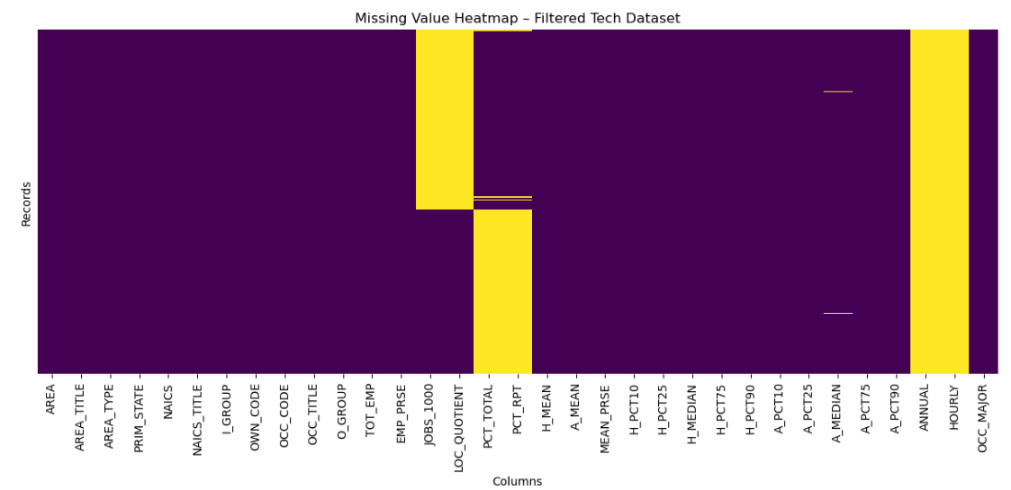
Preparing the BLS OEWS Dataset for Modeling
Handling Missing Values:
Columns with 100% missing values were removed
Sparse features were reviewed for possible aggregation
Null checks and percentage summaries were performed across all features
Missing Value Heatmap To assess data quality, we visualized missing values across all columns in the filtered tech dataset. The heatmap reveals that most key features (occupation, region, salary, employment) are well-populated, with only a few columns requiring further review or removal. This step ensured that we proceeded with a clean and reliable dataset for analysis and modeling.

Slide 12
Preparing the BLS OEWS Dataset for Modeling
Feature Selection:
Kept modeling-relevant fields:
OCC_TITLE (occupation)
AREA_TITLE (location)
NAICS_TITLE (industry)
TOT_EMP (employment count)
A_MEDIAN / A_MEAN (target variables)
Prepared categorical variables for encoding:
Grouped overly specific titles into broader categories
Reserved space for encoding via one-hot or label methods

Slide 13
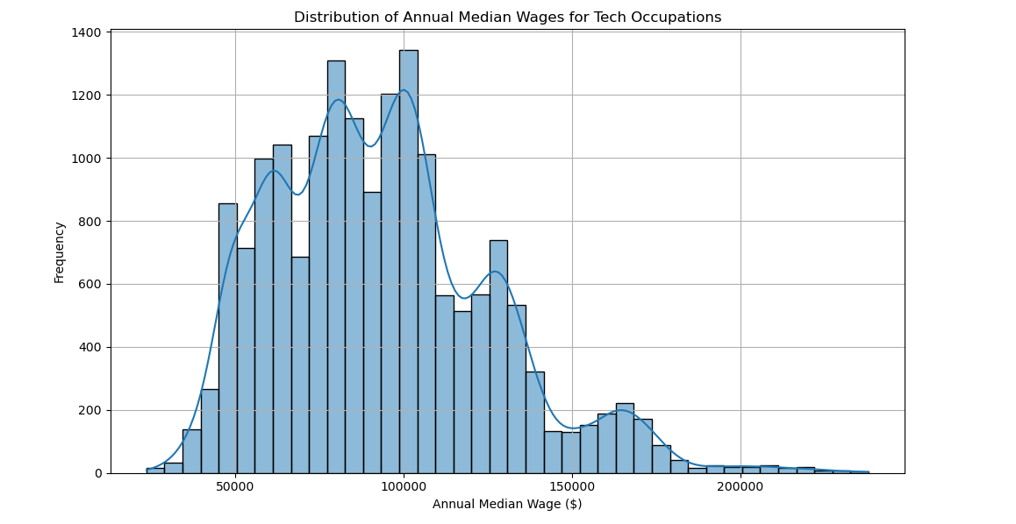
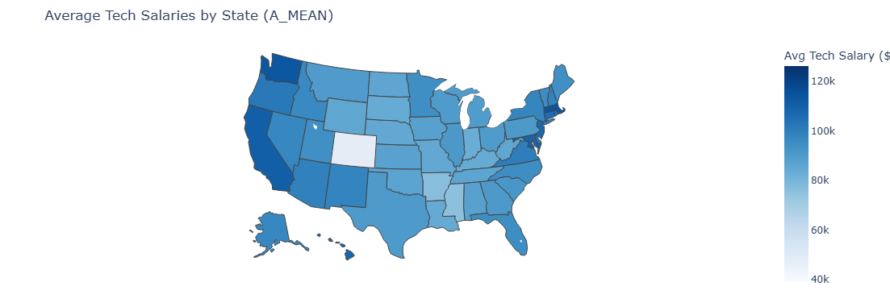
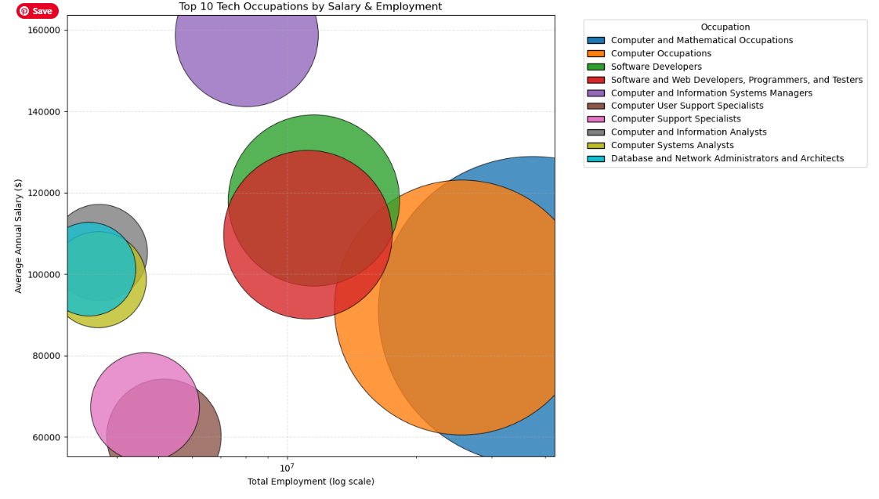
Exploring Tech Salary & Employment Patterns
Cleaned dataset used to analyze salary trends across U.S. tech occupations and regions
Visualized distributions, correlations, and regional disparities
Confirmed strong linear relationships between wage fields (e.g., A_MEAN, A_MEDIAN)

Slide 14
Modeling Approach and Training Process
Target variable & Models Trained
Features used
A_MEDIAN (annual median wage)
Ridge Regression
Random Forest Regressor
Encoded:
OCC_TITLE,
AREA_TITLE,
NAICS_TITLE,
TOT_EMP
Data split
Feature encoding
Training: 70%
Validation: 15%
Testing: 15%
One-hot for categorical features

Slide 15
Model Performance & Comparison
Metric Used: Root Mean Squared Error (RMSE)
Validation Results:
Ridge Regression: RMSE = 29,922.20
Random Forest: RMSE = 17,495.56
Cross-Validation (Ridge):
Mean RMSE across 5 folds: 31,261.60
Test Set Performance:
Random Forest Test RMSE: 17,502.32

Slide 16
Timeline and Future Milestones
Phase 1: Project Pitch (Completed)
Phase 2: EDA & Model Construction (Current)
Phase 3: Interpretation & Iteration (Upcoming)
Phase 4: Final Presentation & Delivery
Finalized topic, collected datasets, and defined objectives
Conducted initial data cleaning and EDA previews
Completed data preparation and cleaning
Performed EDA, visualizations, and pattern discovery
Trained and evaluated regression models
Refine model performance
Add advanced techniques (e.g., feature selection, clustering)
Supplement analysis with Stack Overflow dataset
Prepare visual dashboards and final report
Submit final slide deck, notebook, and written report
Showcase results and interpretations clearly and accessibly

Slide 17
Risks & Mitigations
During Phase 2, we faced several practical challenges typical of large public datasets. A significant portion of the raw BLS data contained suppressed or missing values, which we addressed by filtering and retaining only complete, high-quality records. The categorical variables—especially job titles and regions—had high cardinality, requiring thoughtful grouping and encoding to keep the model both interpretable and efficient. To reduce the risk of overfitting, we incorporated cross-validation and maintained a strict training/validation/test split. Finally, given the limited time frame, we prioritized a robust regression pipeline and deferred secondary analysis and clustering for the next phase.

Slide 18
What We’ve Done and Why It Matters
Built a reproducible pipeline using public U.S. labor data
Explored salary trends across tech occupations and regions
Constructed and evaluated regression models to predict wages
Highlighted disparities in compensation by role, location, and industry
Laid the groundwork for extended analysis in Phase 3

Slide 19
Data Sources & Supporting Materials
Datasets:
U.S. Bureau of Labor Statistics (OEWS 2024) https://www.bls.gov/oes/special-requests/oesm24all.zip
Stack Overflow Developer Survey 2024 https://survey.stackoverflow.co/datasets/stack-overflow-developer-survey-2024.zip
Tools & Libraries:
Python 3.11, Pandas, NumPy, Seaborn, Matplotlib, Scikit-learn
Jupyter Notebook, GitHub
Background Reading:
Pedregosa et al. (2011). Scikit-learn: Machine Learning in Python. Journal of Machine Learning Research.
Stack Overflow Insights. (2024). Developer Survey Results.
U.S. Department of Labor. (2024). Occupational Employment and Wage Statistics (OEWS).

Slide 20
Thank you
Questions?
Notes:
“Thank you! We’re happy to take any questions or suggestions.
Feel free to visit our GitHub or reach out for more details.”

